Slide 1

Session II
Cognitive neuroscience
By Pascal Kropf and Sujaya Neupane
no_reply@example.com
Notes:
In this session we will talk a little about cognitive neuroscience which is a fairly young field of science. A lot of what is called cognitive neuroscience is essentially psychology and the questions being asked are related to the questions of the mind and behaviour. Since we are here to learn about AI, the neuroscience we are going to learn will be in relation to AI.

Slide 2
What is intelligence?

Slide 3
Intelligence is about modeling the world…
explaining and understanding what we see.
imagining things we could see but haven’t yet.
problem solving and planning actions to make these things real.
building new models as we learn more about the world.
Slide from Josh Tenenbaum, MIT
Notes:
Since intelligence is not just detecting patterns in data. We can view intelligence as someone that is capable of modeling the world in terms of understanding what we see as well as imagining things to make predictions and so on. There could be many definitions of intelligence and it would also depend on each person’s view on the word.
Pattern recognition which is what deep learning does is a machine learning technique. It can be considered ‘an intelligent technique’ but we would need an agent to make a deicsion of some sort if we are talking about intelligent agent. Therefore RF would be one example of a technique that can be compared to a human.

Slide 4
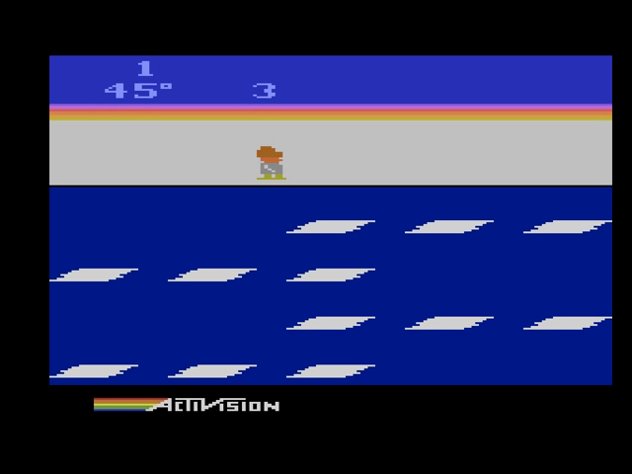
Let’s learn to play Atari!
And compare ourselves against Deep RL.
Frostbite: http://www.virtualatari.org/soft.php?soft=Frostbite
Slide from Josh Tenenbaum, MIT
Notes:
Let’s start by an activity and we will discuss further.
First play for a few minutes on your own. Then we’ll watch a good player.

Slide 5
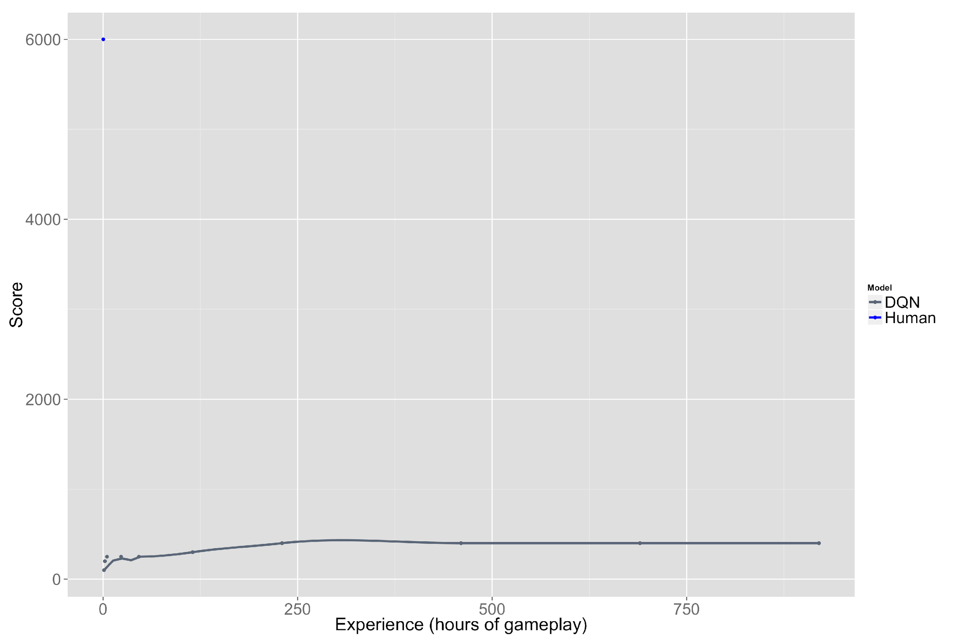
Frostbite
0 250 500 750
Experience (hours of gameplay)
Slide from Josh Tenenbaum, MIT

Slide 6
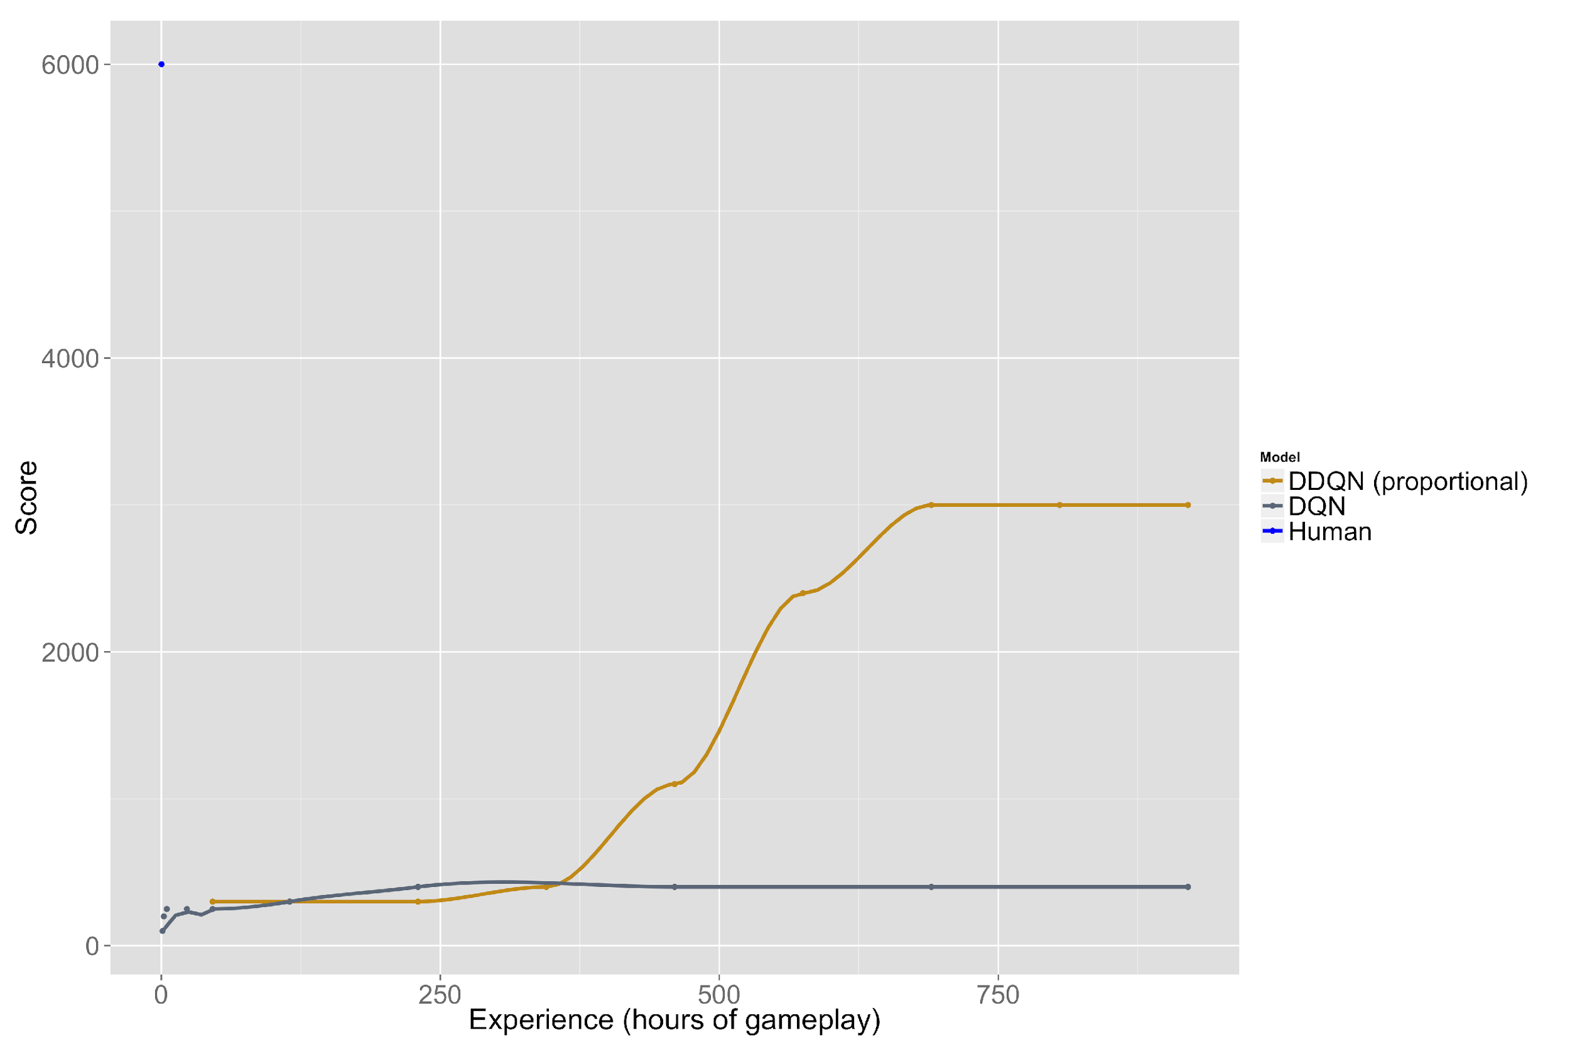
Frostbite
0 250 500 750
Experience (hours of gameplay)
Slide from Josh Tenenbaum, MIT

Slide 7
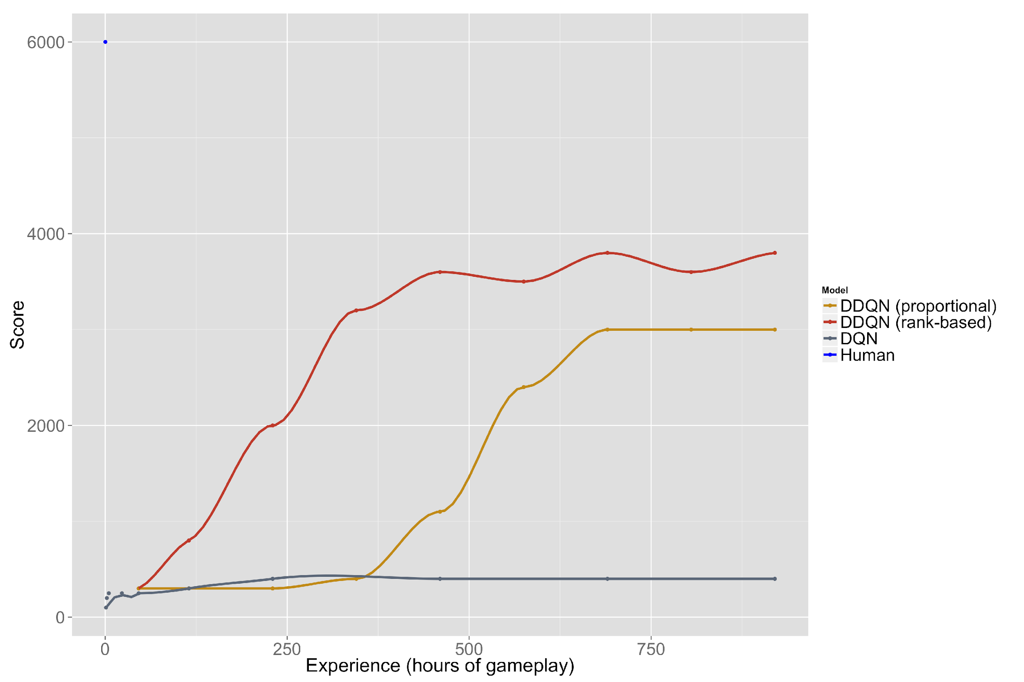
Frostbite
0 250 500 750
Experience (hours of gameplay)
Slide from Josh Tenenbaum, MIT

Slide 8
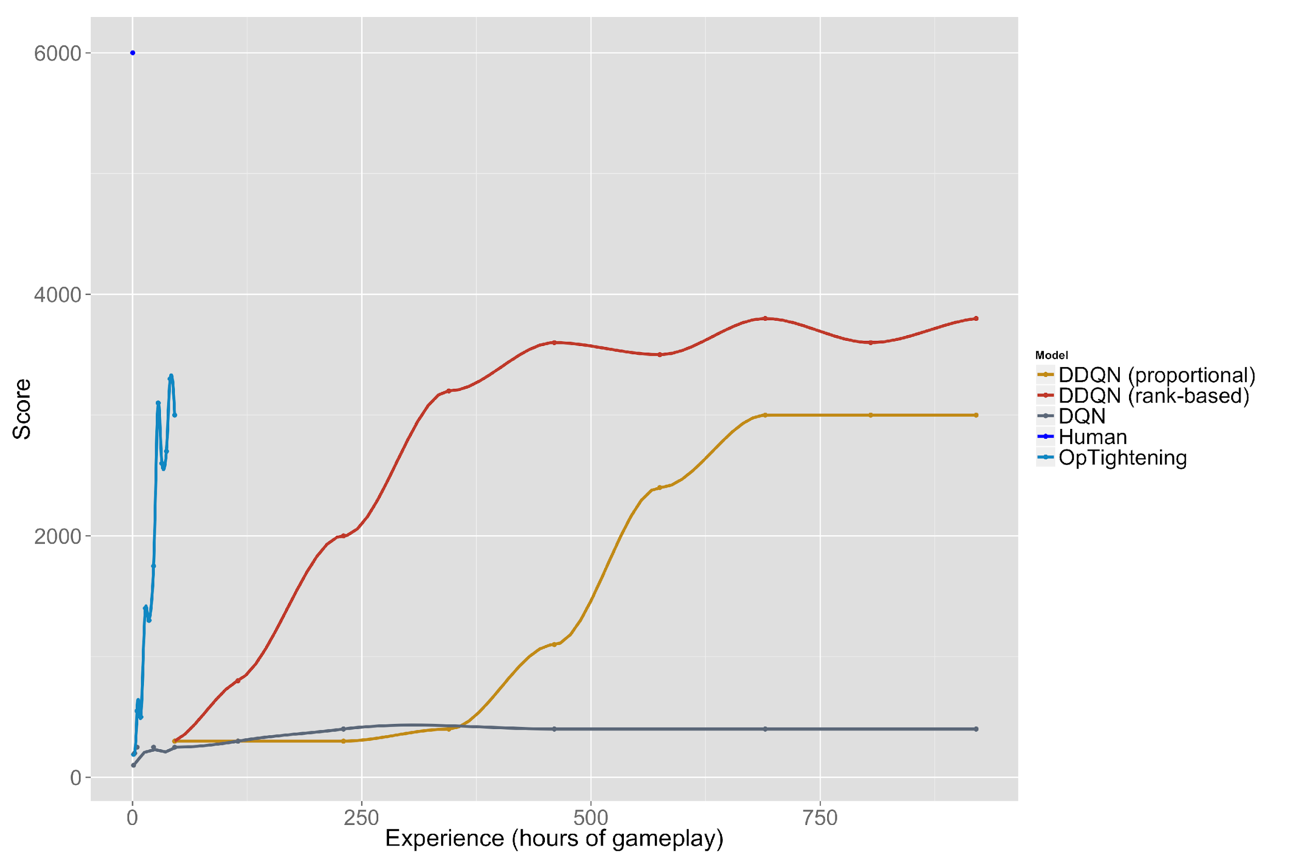
Frostbite
(He et al., ICLR 2017 submitted)
0 250 500 750
Experience (hours of gameplay)
Slide from Josh Tenenbaum, MIT

Slide 9
Frostbite
(He et al., ICLR 2017 submitted)
0 250 500 750
Experience (hours of gameplay)
Slide from Josh Tenenbaum, MIT
Notes:
OpTightening: Optimality Tightening, by He, Liu, Schwing, Peng (all at Illinois, Urbana-Champaign)

Slide 10
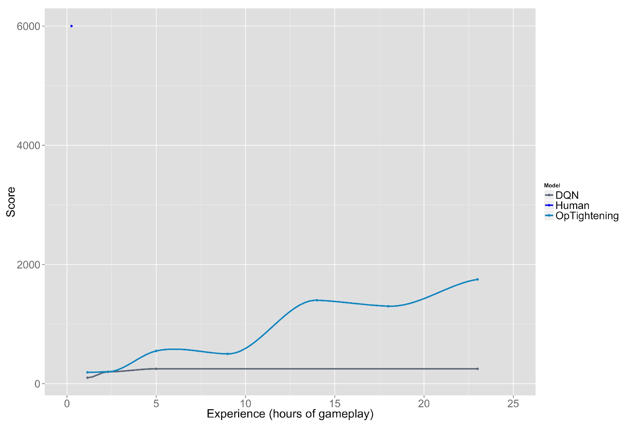
Frostbite
(He et al., ICLR 2017 submitted)
0 5 10 15 20 25
Experience (hours of gameplay)
Slide from Josh Tenenbaum, MIT

Slide 11
Frostbite
(He et al., ICLR 2017 submitted)
0 5 10 15 20 25
Experience (hours of gameplay)
Slide from Josh Tenenbaum, MIT

Slide 12
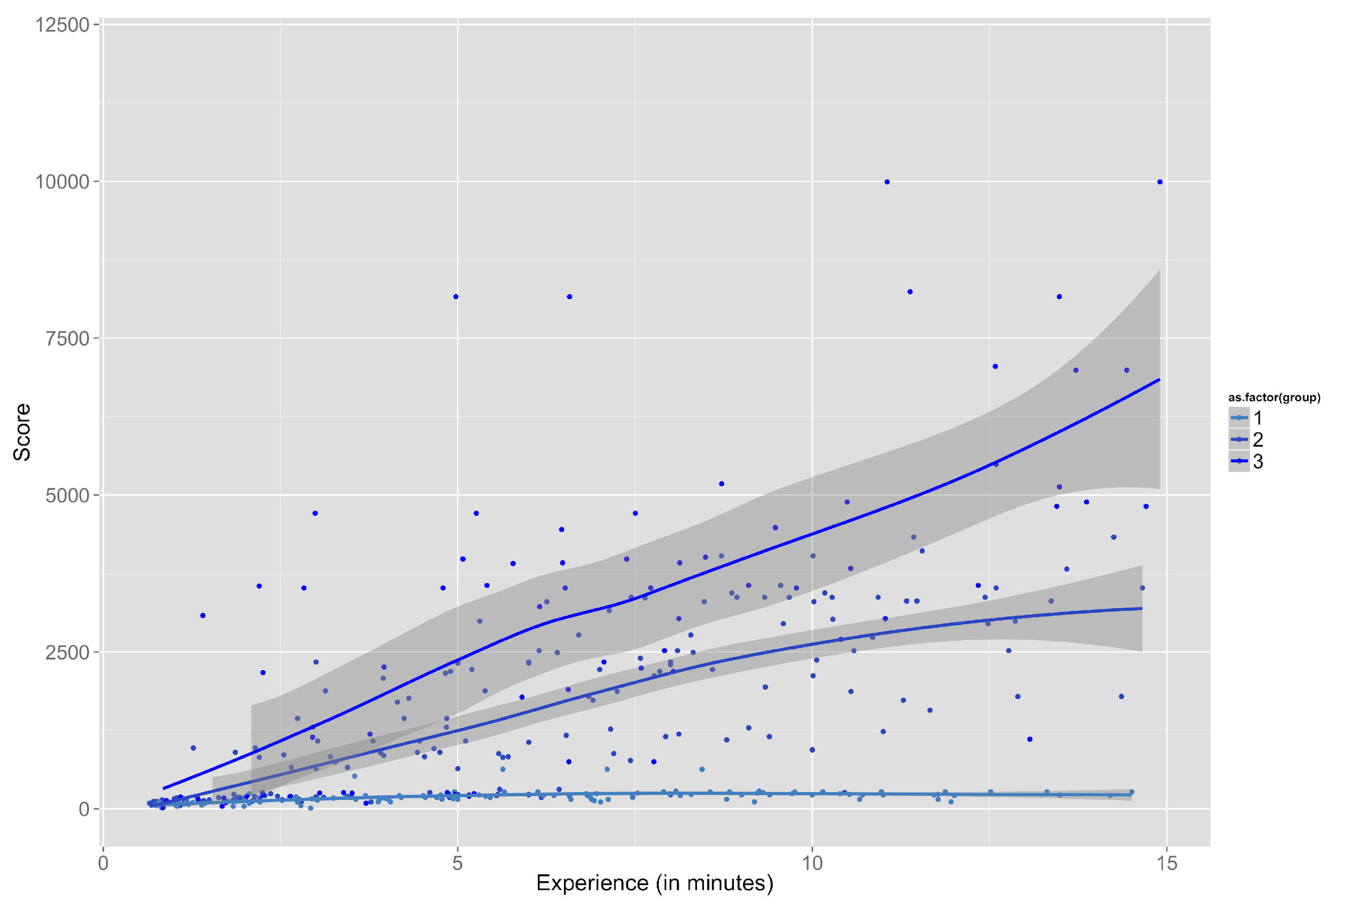
Frostbite
Top 33%
Middle 33%
Bottom 33%
OpTightening
DQN
0 5 10 15
Experience (minutes of gameplay)
Slide from Josh Tenenbaum, MIT
Notes:
Clearly, humans outperform by a large margin even the best available AI algorithm.
In order to understand our own behaviour and ‘intelligence’, we now can look into the field of psychology and neuroscience and see what we know in these fields and see if AI can learn something for a meaningful progress.

Slide 13
Taking stock with Atari
What are artificial neural networks good at?
What are they not (yet) so good at?
Slide from Josh Tenenbaum, MIT
Notes:
Let’s think about why this is the case.

Slide 14
Taking stock with Atari
What are artificial neural networks good at?
- Learning spatiotemporal patterns that are consistent across many experiences
- Responding quickly once they’ve learned
What are they not (yet) so good at?
- Learning about kinds of things, and cause-effect relations between events, from one or a few experiences
- Seeing things and events
- Forming goals, subgoals and plans
- Exploring, being curious, experimenting
- Learning from others
What are we (humans or human mind or animal mind) good at?
- Learning quickly and behaving flexibly
- Many other things NNs are not (yet) so good at
Modified from Josh Tenenbaum’s
Notes:
If you are not familiar with ANNs yet, you will learn about them I coming days. But essentially, artificial neural networks are good at learning patterns. They are designed to be that way. Once learned, they perform very quickly. One of the things that distinguishes a NN from a human mind is that the human mind learns much ore faster as you saw from the demonstration. Besides that, what we learn is also be generalized giving rise to flexible behavior. We will see what I mean by generalizable and flexible behavior in a little bit.

Slide 15
Cognitive psychology: recent history
Behaviourism (1920s to 1950s)
Classical conditioning (Pavlov’s dogs)
Cognitive revolution (1950s)
Notes:
The question of how we learn is an interesting one because it seems to be happening apparently without us noticing it too much. Let’s think about language learning. It just happens. Of course we spend conscious effort to learn certain things like this winter school. But we can just look at very simple things which gives us profound insights into how something like learning could be happening.
In the 1920s, because of a particular obsevation by some psychologists, learning generated a huge scientific interest gave rise to a field of psychology called behaviourism. Let’s see what this experiment was.

Slide 16
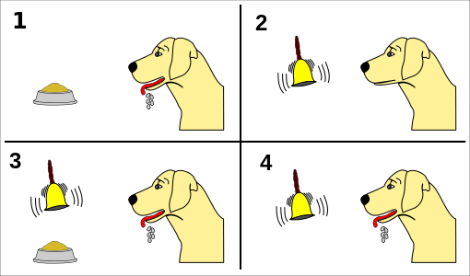
Pavlov’s dogs and behaviorism
Classical conditioning
Notes:
Ivan Pavlov, a Russian scientist gave his dog some food and noticed that he was salivating. He would not salivate if Pavlov did something like ring a bell or call his name in a particular way or sing a song. At some point he started giving the food to the dog and simultaneously playing a bell. Of course he salivated as there was food. Eventually, when he just rang the bell without any food, the dog still salivated. This observation was very surprising and had a profound implication. The dog can learn something completely random by association. He learned that a bell meant there is food coming.
Now let’s think about what this means. It means that everything you learn is based on associative memory of things happening together.

Slide 17
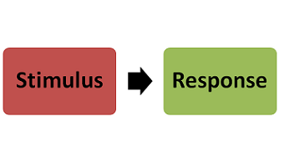
Pavlov’s dogs and behaviorism
Classical conditioning
Implications | Problems
No need of mental processes or ‘mind’ | Doesn’t explain thoughts and decision processes which involve mental processes
Associative memory | Doesn’t explain inference
Associationism | Doesn’t explain flexible behaviour
Notes:
Ivan Pavlov, a Russian scientist gave his dog some food and noticed that he was salivating. He would not salivate if Pavlov did something like ring a bell or call his name in a particular way or sing a song. At some point he started giving the food to the dog and simultaneously playing a bell. Of course he salivated as there was food. Eventually, when he just rang the bell without any food, the dog still salivated. This observation was very surprising and had a profound implication. The dog can learn something completely random by association. He learned that a bell meant there is food coming.
Now let’s think about what this means. It means that everything you learn is based on associative memory of things happening together.
What are the other implication of this S-R model of learning?

Slide 18
Cognitive psychology: recent history
Behaviourism (1920s to 1950s)
Classical conditioning (Pavlov’s dogs)
Operant conditioning (model-free reinforcement learning)
Cognitive revolution (1950s)
Internal model
Notes:
Now, there are problems with behaviorism. It leaves no room for any of the internal mental processes happening in the brain. Cognitive revolution is the time in the 1950s when people started concluding that behaviorism leaves a lot of unresolved questions about the mental processes.
Let’s think about it a bit, but in order to think about it you can either just listen to me and believe me. This way, you will avoid going through the thinking and understanding process. Because this is not a trivial topic to grasp, and if you want to have some serious understanding, you have to put some effort to get into the messy details. Therefore, we will spend next 30-45 minutes reading and discussing an important paper which started questioning with empirical proofs, the theory of learning of behaviorism.

Slide 19
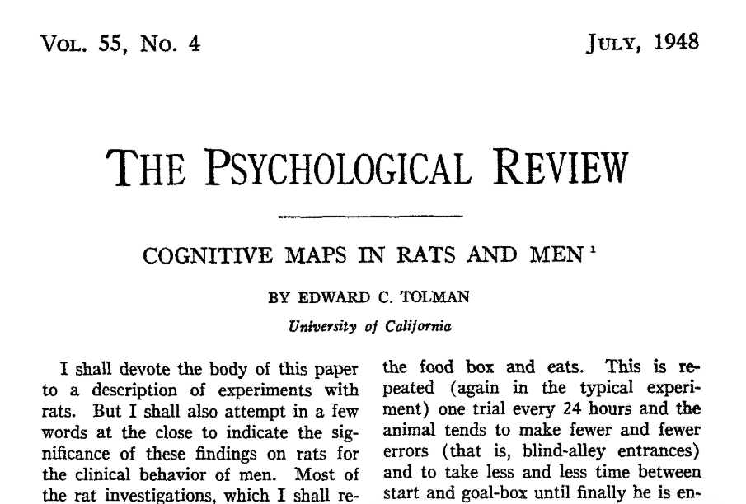
Group activity
Tolman (1948)
Let’s read
Introduction (pg 1-5)
Two experiments:
Latent learning Figs 4,5,6,7
Spatial orientation Figs 15,16,17
Summary

Slide 20
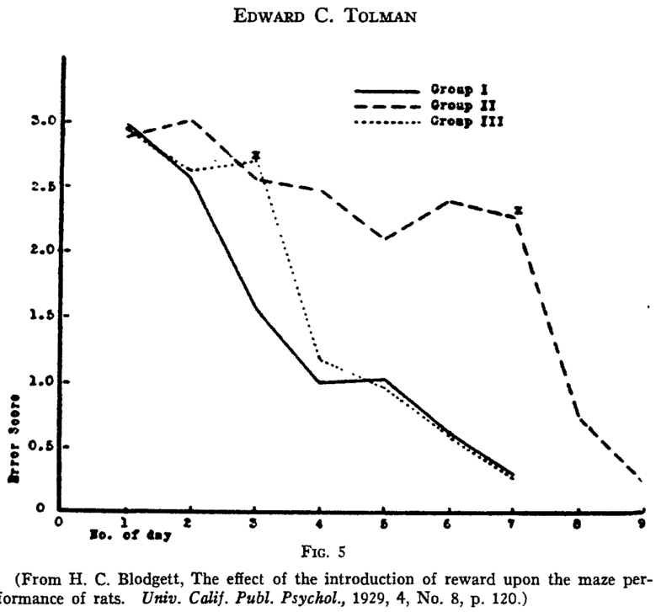
Tolman’s rats
Notes:
Around the same time, others were doing experiments in other species which indicated that there was more than S-R type learning happening in the animal’s behaviour. Here is aanother example of such an observation. Can you guess what is so special about this plot? The experiment is that monkeys are required to make a decision on binary choice; one of the two choices is loaded with reward and every 10 trials new pair of objects are used.

Slide 21
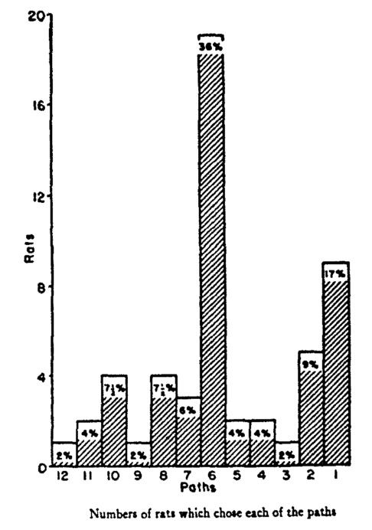
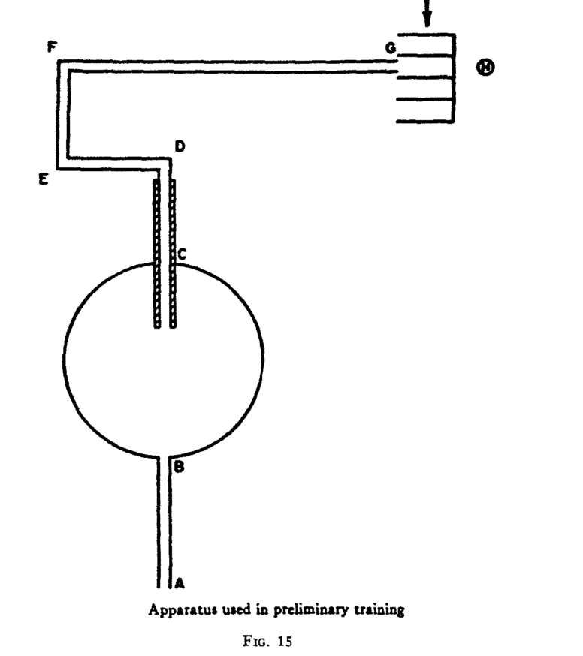
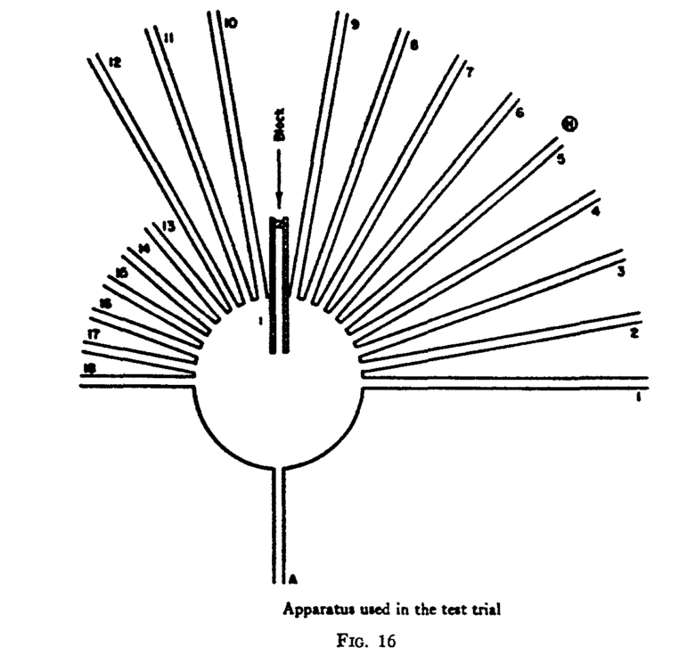
Tolman’s rats
Tolman (1948)
Notes:
Tolman designed clever experiments to show that rats do more than hit and trial to navigate around their environment. They have a sense of their environment putatively as a cognitive map. Here a rat is exploring bla bla
If cognitive map theory is true and place cells are the building blocks of it, various analogues of place cells should be observed if a subject is navigating not just spatial map or other forms of abstract spaces. For example:

Slide 22
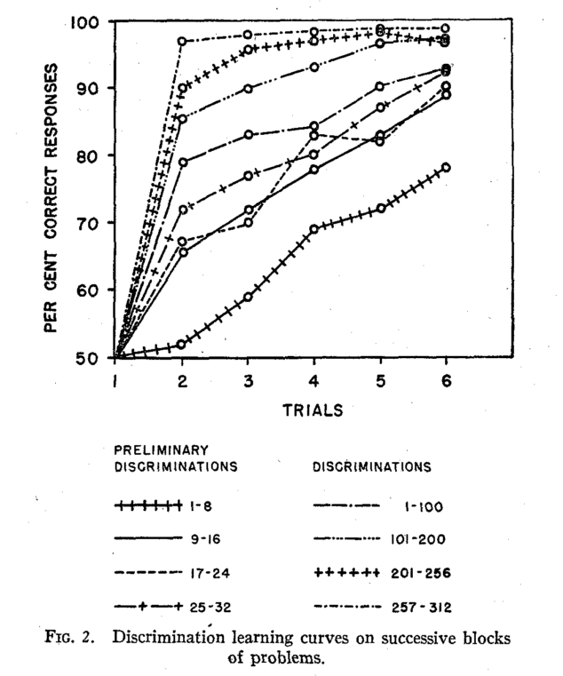
Harlow’s monkeys: learning the rules

Slide 23
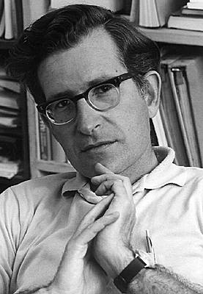
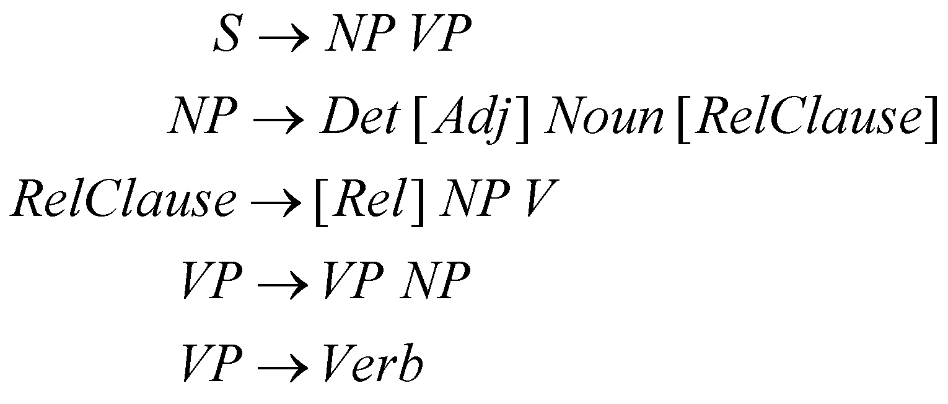
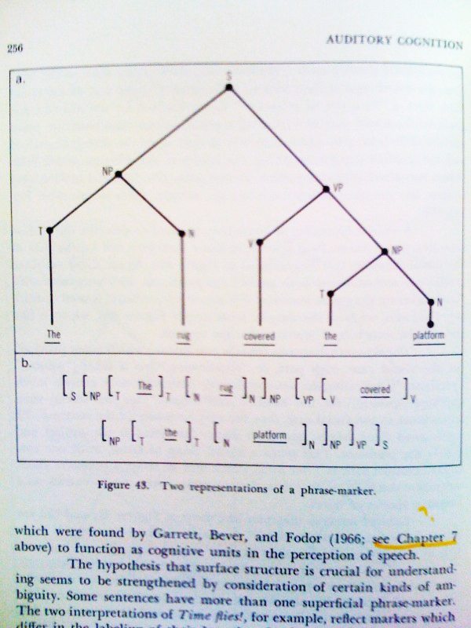
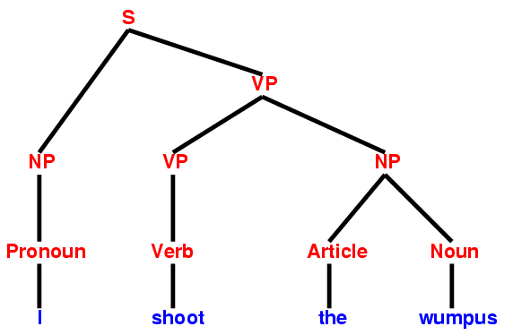
Chomsky’s humans
“The infinite use of finite means”
S
I thought that the rug covering the platform was covered in dust, but it was actually covered in the ground-up bodily remains of hundreds of thousands of tiny coral-like organisms who lived millions of years ago at the bottom of an ocean that has long since disappeared, except in the thoughts of certain geologists who remember it all too well.
VP
NP
NP
V
D
N
D
N
The rug covered the platform
I thought that the rug covering the platform was covered with dust, but hundreds of thousands of small coral-like creatures that lived on the bottom of the long sea hundreds of years ago, since then, It disappeared except for the particular geologist's remembrance that I remember.
The rug covering the platform was covered in dust.
I thought that the rug covering the platform was covered in dust, but it was actually covered in silver!
Notes:
One of the ground breaking contribution to cognitive revolution was Noam Chomsky’s idea of how lnaguage acquisition works in humans. He not only suggested that there is a mental process involved in language production, he also formed a mathematical formulation to try to model that process. He put emphasis on the generative process of language and proposed that there is a universal sort of syntax in every human innately which enables language acquistion and eventually utterance.
We can think of intelligence as symbolic computation. It’s really about flexibility which can be summarized in this phrase ‘Infinite use of finite means’. Linguistic capacity of humans is a perfect example of this flexibility. With very little means of vocabulary and grammar rules, one can compose sentences in infinite ways.

Slide 24
Cognitive revolution
Gave rise to a new field of “cognitive psychology”
“Mental processes” also have effect on behavior, not just stimulus and reinforcement
What are these mental processes?
Attention (think of pavlov’s dog that pays no attention to a bell)
Memory
Prior knowledge (from experience or by birth?)
What about deep learning that sovles a lot of problems?
Judea Pearl “Deep learning shows that a lot of problems we thought were hard, aren’t actually that hard.”
What are the hard problems?
The questions about intelligence are hard and we are far from solving them.
Notes:
But obviously S-R response was also not complete bogus. We do have something like procedural memory. Especially after the 1980s, with the rise of artificial neural network associationism came back to prominence.

Slide 25
The big questions
How can the same intelligent system learn do so many things so well, without having to be specially engineered or extensively trained?
How does the human mind get so much from so little? How could machines?
What is the nature of human common sense?
What is built in, and how do you learn the rest?
Can you actually learn to be intelligent (in general, not just for a specific task)?
How can we characterize human intelligence in computational terms?
What kind of computer is the brain/mind?
Slide from Josh Tenenbaum, MIT

Slide 26
Cognitive science now
Daniel Khaneman’s dual process theory
Intuitive process (fast process)
Associative memory
Related to classical conditioning
Artificial neural network and most of deep learning
Reasoning (slow process)
Internal models of the world
Conscious judgment
Decisions based on cognitive map and latent learning
Notes:
Daniel Khaneman, a nobel prize winning econommist has proposed this idea of slow thinking and fast thinking and it makes sense to me at last to reconcile the existence of S-R type associative memoery based process and internal model based cognitive map-like slow process.

Slide 27
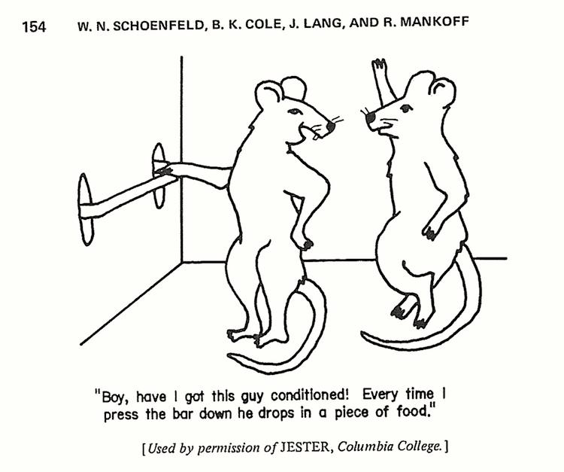
Summary takeaways
Humans outperform AI to generalize what’s learned
Significant progress has been made in our understanding of how animal and human cognition works
AI research can draw from cognitive sciences to make progress

Slide 28
The big questions
How can the same intelligent system learn do so many things so well, without having to be specially engineered or extensively trained?
How does the human mind get so much from so little? How could machines?
What is the nature of human common sense?
What is built in, and how do you learn the rest?
Can you actually learn to be intelligent (in general, not just for a specific task)?
How can we characterize human intelligence in computational terms?
What kind of computer is the brain/mind?
Slide from Josh Tenenbaum, MIT

Slide 29
Break between session I and II

Slide 30
The big questions
How can the same intelligent system learn do so many things so well, without having to be specially engineered or extensively trained?
How does the human mind get so much from so little? How could machines?
What is the nature of human common sense?
What is built in, and how do you learn the rest?
Can you actually learn to be intelligent (in general, not just for a specific task)?
How can we characterize human intelligence in computational terms?
What kind of computer is the brain/mind?
Slide from Josh Tenenbaum, MIT

Slide 31
Reverse-engineering a cognitive system: Marr-Poggio levels
Level 1: Computational theory
What are the inputs and outputs to the computation, what is its goal, and what is the logic by which it is carried out?
Level 2: Representation and algorithm
How is information represented and processed to achieve the computational goal?
Level 3: Hardware implementation
How is the computation realized physically?
Slide from Josh Tenenbaum, MIT

Slide 32
Marr’s 3 levels applied to cognition
Computational: What is the problem that cognition has to solve? What is the logic?
Algorithmic: What algorithms are used to approach the problem?
Implementational: How is the algorithm implemented in the brain?

Slide 33
Let’s go back to the problem of rat navigation
Computational: What is the problem that cognition has to solve? What is the logic?
How do we know where we are in the physical space? And when we move around, how do we keep track of our position?
Logic 1: Use experience to keep track of all the spaces explored in the lifetime
Logic 2: Build a cognitive map of the spatial world
Algorithmic: What algorithms are used to approach the problem?
Implementational: How is the algorithm implemented in the brain?
Notes:
Let’s narrow down a little bit more and think about a specific problem. How do we know where we are in the physical space? And when we move around, how do we keep track of our position?
Let’s think about the logic of the computational principles that can be used to solve this problem

Slide 34
Let’s go back to the problem of rat navigation
Computational: What is the problem that cognition has to solve? What is the logic?
How do we know where we are in the physical space? And when we move around, how do we keep track of our position?
Logic 1: Use experience to keep track of all the spaces explored in the lifetime
Logic 2: Build a cognitive Euclidean map of the spatial world so that one can form new paths
Algorithmic: What representation and algorithms are used to approach the problem?
Deep learning architecture that learns associations using travelled paths
Euclidean map with grids and Euclidean geometry
Implementational: How is the algorithm implemented in the brain?
Notes:
What are the ways in which the problem can be solved? Deep learning?

Slide 35
Let’s go back to the problem of rat navigation
Computational: What is the problem that cognition has to solve? What is the logic?
How do we know where we are in the physical space? And when we move around, how do we keep track of our position?
Logic 1: Use experience to keep track of all the spaces explored in the lifetime
Logic 2: Build a cognitive Euclidean map of the spatial world so that one form new paths
Algorithmic: What representation and algorithms are used to approach the problem?
Deep learning architecture that learns associations based on travelled paths
Euclidean map with grids and Euclidean geometry
Implementational: How is the algorithm implemented in the brain?
Let’s see what neuroscience has to tell us
Notes:
What are the ways in which the problem can be solved? Deep learning?

Slide 36
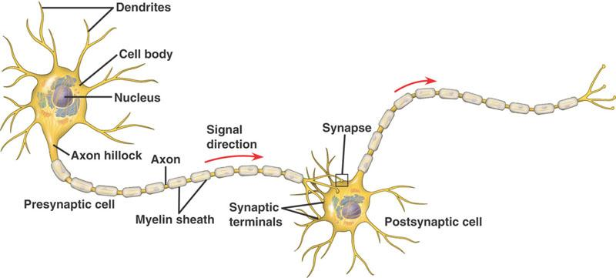
Neuroscience!!
What is inside the brain? Neurons and synapses
What is a neuron?
Notes:
I heard from many of you that you were very excited about neuroscience. So let’s get into some of the messy details about the brain.
It’s known for a long time that there is electrical activity going on in the nervous system, but it was only recently that people were able to record activity of individual neurons in different parts of the brain.

Slide 37
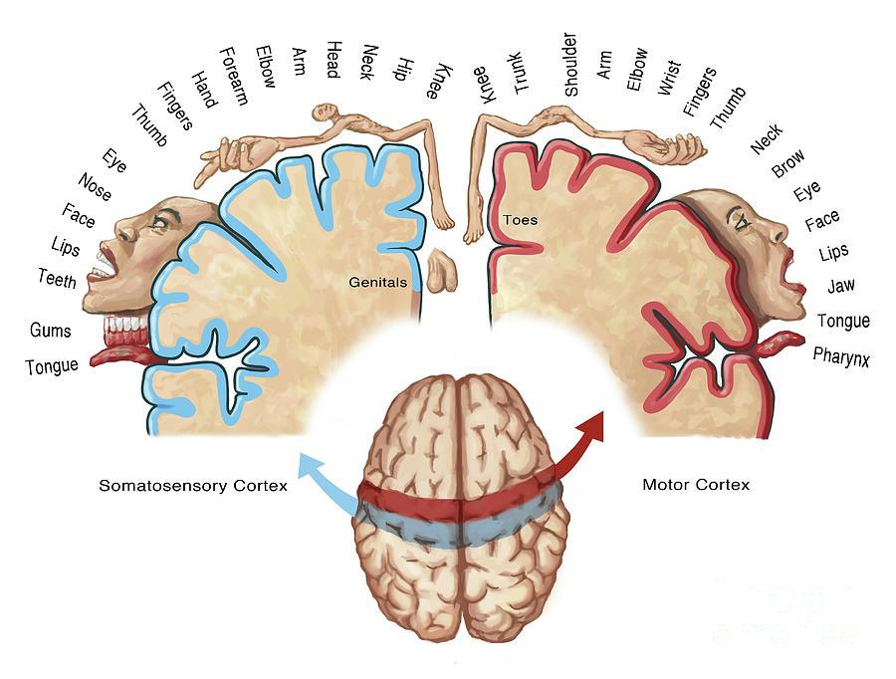
Modularity of functions in the brain
Different areas of the brain is loosely related to different functions and sensations. E.g. Homonculus man represents tactile sensation map

Slide 38
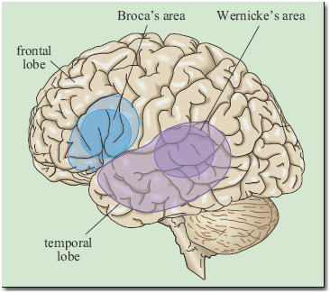
Modularity of functions in the brain
We can categorize according to functions
Mostly mapped by studying patients with lesions in their brain
Visual area
Notes:
I heard from many of you that you were very excited about neuroscience. So let’s get into some of the messy details about the brain.
It’s known for a long time that there is electrical activity going on in the nervous system, but it was only recently that people were able to record activity of individual neurons in different parts of the brain.

Slide 39
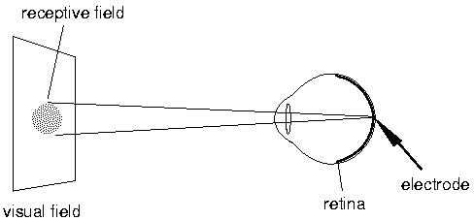
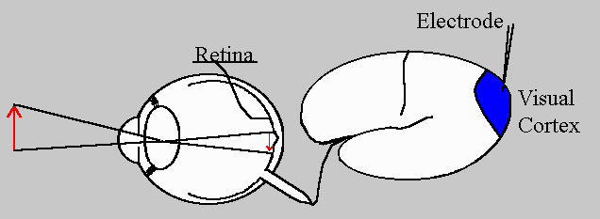
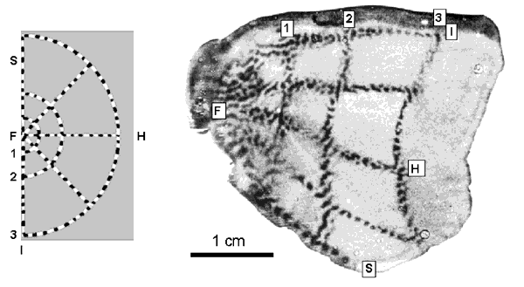
Receptive Field
Hubel and Wiesel, 1962
Notes:
important to understand a fundamental concept in sensory neuroscience which is that of receptive field. If we record from a retinal cell, it only responds to a particular location on the visual field. This sensitive area is called the receptive field of that cell.
An adjacent cell would have its own receptive field adjacent to the first receptive field. This type of organization is conserved throughout the visual system and is thought to be the building blocks of the perceptual “whole” that develops early in life with little subsequent changes.
The figure in the bottom right shows various spots on the visual field. The one of the left shows neurons on visual cortex area V1 that are sensitive to corresponding locations. Note that these experiments were done during stable fixation or under anesthesia/paralysis. In awake condition…

Slide 40
Orientation selective cells and edge detection
https://www.youtube.com/watch?v=IOHayh06LJ4

Slide 41
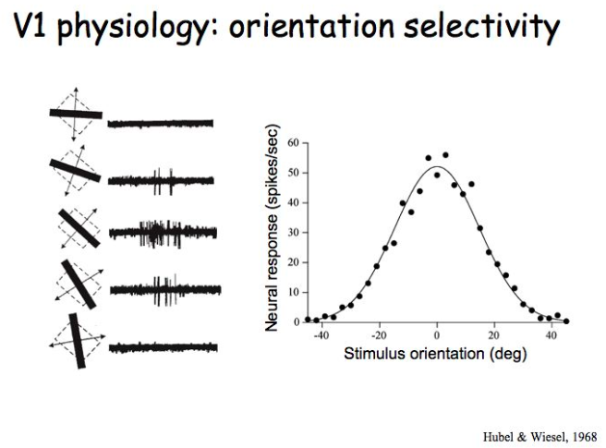
Visual system and CNN
http://www.cns.nyu.edu/~david/courses/perception/lecturenotes/V1/lgn-V1.html
Notes:
I heard from many of you that you were very excited about neuroscience. So let’s get into some of the messy details about the brain. Let’s see

Slide 42
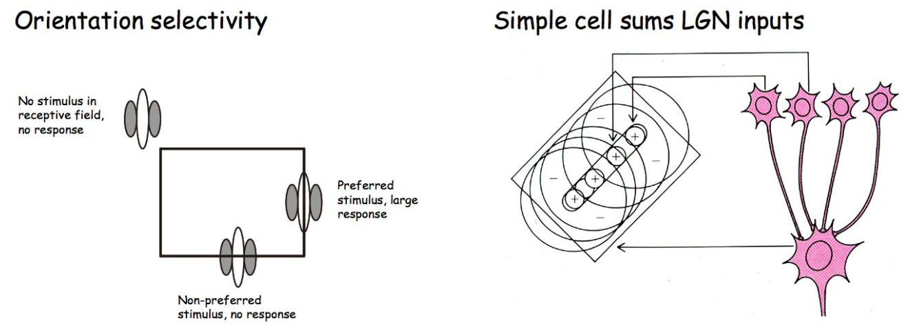
Visual system and CNN
Notes:
I heard from many of you that you were very excited about neuroscience. So let’s get into some of the messy details about the brain. Let’s see

Slide 43
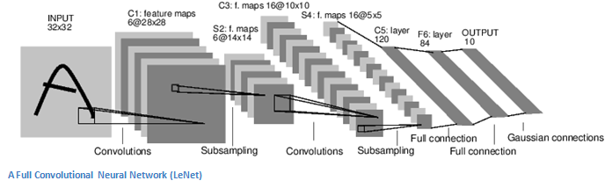
Visual system and CNN
What makes it work? Back propagation
But no evidence of back propagation in the brain
http://www.cns.nyu.edu/~david/courses/perception/lecturenotes/V1/lgn-V1.html
Notes:
I heard from many of you that you were very excited about neuroscience. So let’s get into some of the messy details about the brain. Let’s see

Slide 44
Let’s go back to the problem of rat navigation
Computational: What is the problem that cognition has to solve? What is the logic?
How do we know where we are in the physical space? And when we move around, how do we keep track of our position?
Logic 1: Use experience to keep track of all the spaces explored in the lifetime
Logic 2: Build a cognitive Euclidean map of the spatial world so that one form new paths
Algorithmic: What representation and algorithms are used to approach the problem?
Deep learning architecture that learns associations based on travelled paths
Euclidean map with grids and Euclidean geometry
Implementational: How is the algorithm implemented in the brain?
Let’s see what neuroscience has to tell us
Notes:
What are the ways in which the problem can be solved? Deep learning?

Slide 45
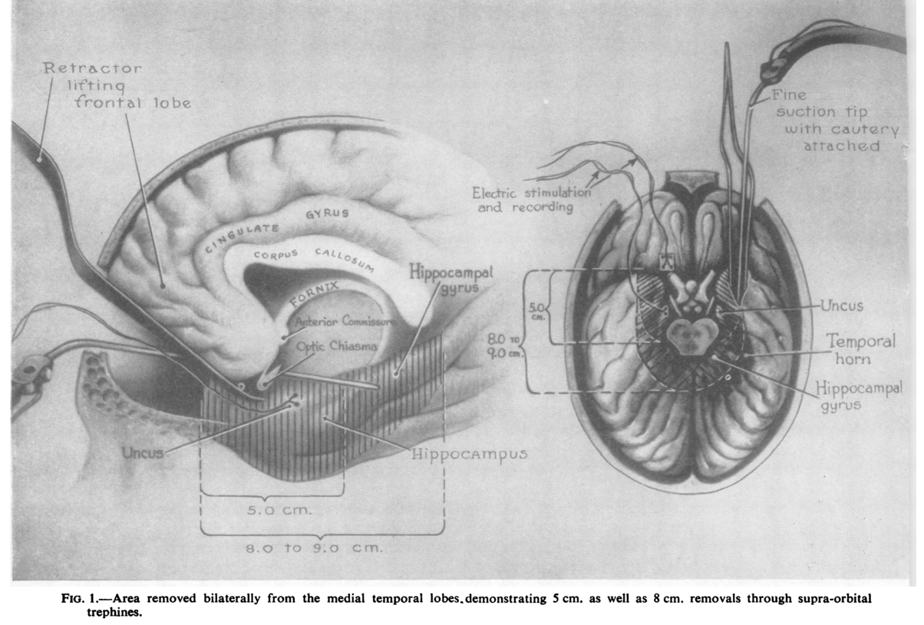
Hippocampal damage and memory
“…a grave loss of recent memory…
In the non-psychotic patient [HM] the loss was immediately apparent. After operation this young man could no longer recognize the hospital staff nor find his way to the bathroom…His early memories were apparently vivid
…his mother, still has to tell him where to find the lawn mower, even though he may have been using it only the day before.
…he will do the same jigsaw puzzles day after day without showing any practice effect…”
Scoville and Milner (1957)
Notes:
Memory research received a ground breaking boost form Milner’s work showing link between hippocampus and short term memory

Slide 46
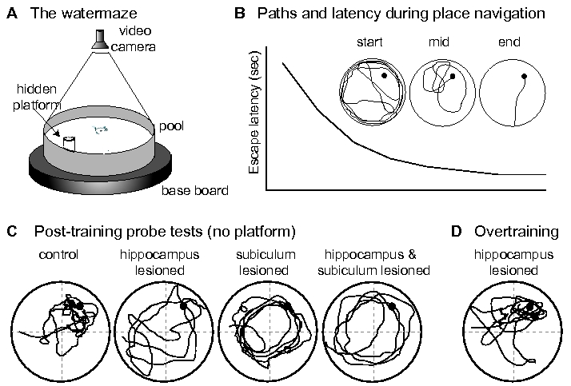
Hippocampal damage and spatial navigation: Morris water maze
http://www.scholarpedia.org/article/Morris_water_maze
Notes:
Richard Morris devised a special experimental paradigm to assess the navigation abilities of rats by making them swim to a hidden target in a colored water tank. Why do you think this is so novel?

Slide 47
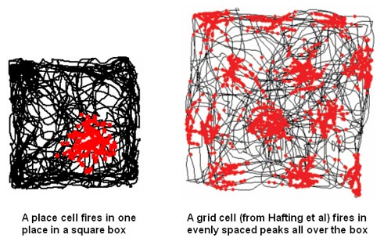
Phenomenal cells of hippocampus
Head direction cells (Taube, Muller, Ranck)
Border cells (Moser, Moser)
Speed cells (Moser, Moser)
O’keefe and Dostrovsky(1971); Hafting, Moser, Moser (2005)
Notes:
O’keefe recorded from hippocamapal cells by devising a way to record from freely moving rats in 1960s. Discovery of place cells opened a new field of spatial navigation and hippocampus and subsequently variety of other types of phenomenal cells have been found in hippocampus and entorhinal cortex such as head direction cells (subiculum), border cells, speed cells. Grid cells have also been found in free viewing monkeys and epileptic patients’ MEC.
Back to the 60s - discovery of place cells in the hippocampus linked hippocampus to the cognitive map theory originally proposed by Tolman (1948). These two findings (hippocampus for memory and place cells) created their own fields for ~50 years but the link between the two is missing. Both involve hippocampus.

Slide 48
What have we learned so far
Humans outperform AI to generalize what’s learned
Significant progress has been made in our understanding of how animal and human cognition works
AI research can draw from neuroscience research to make progress
Marr’s 3 level of analysis to approach a problem is a way for AI research to
Brain has phenomenal neurons with properties hinting towards a map-like representation to solve navigation problem and so does a deep reccurent network
But we still don’t know why these cells are there and how it is used if at all used for vector calculation

Slide 49
So why is neuroscience relevant?
AI is trying to build intelligent agents
Neuroscience is trying understand how the brain works
In other words, we are trying to understand ourselves
How can we build intelligence without understanding intelligence?

Slide 50
Break betweek session II and III

Slide 51
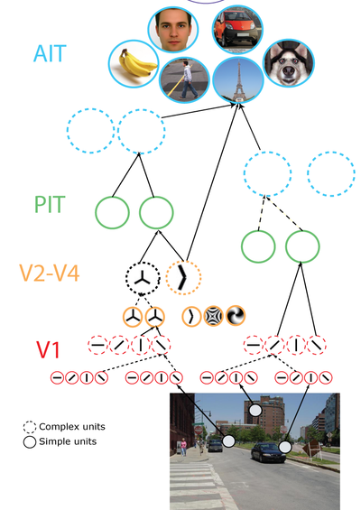
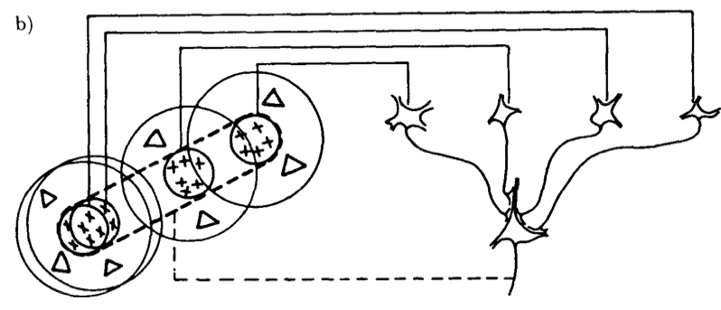
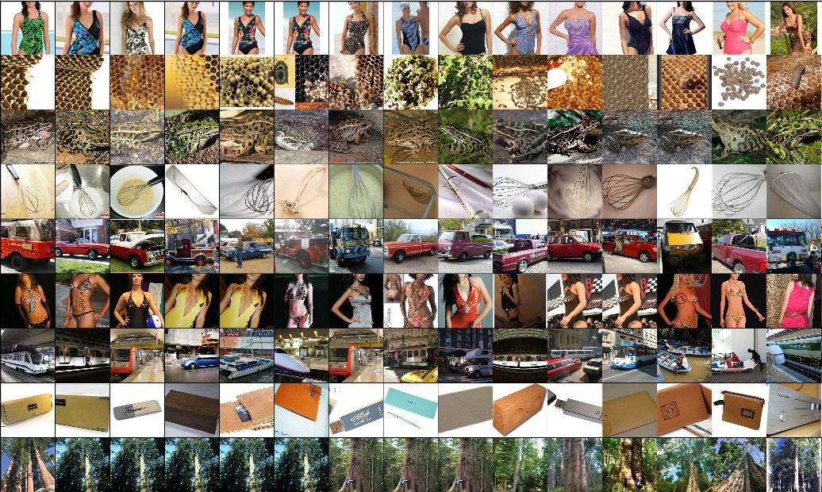
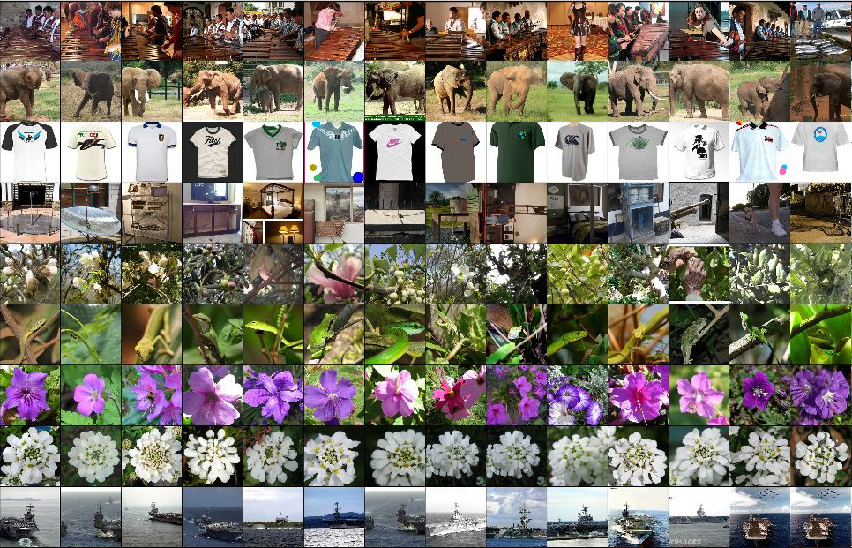
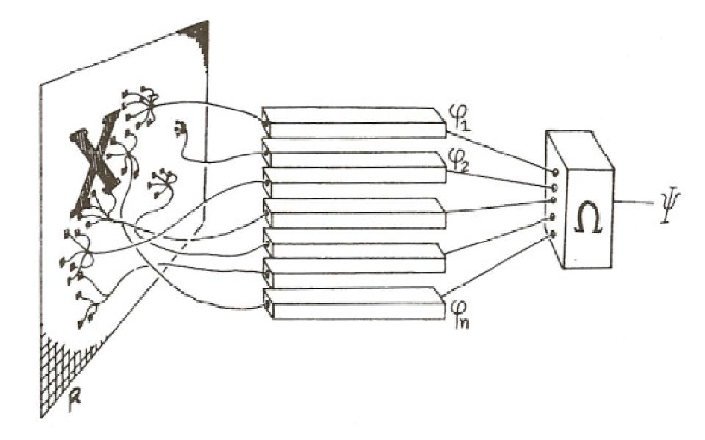
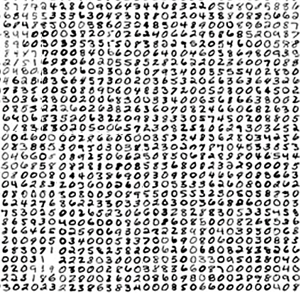
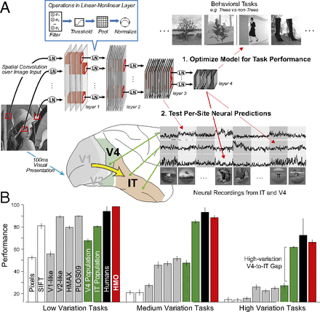
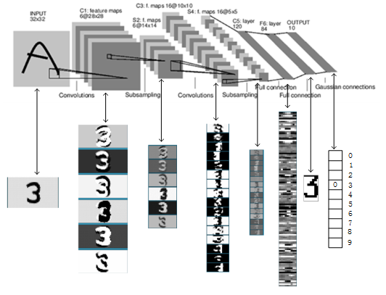
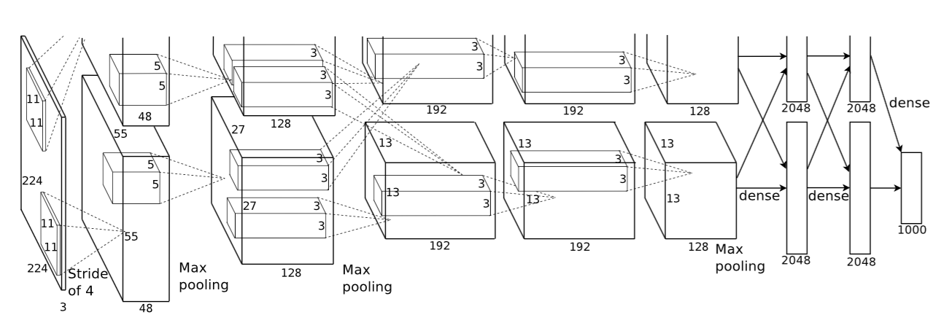
Pattern recognition engine?
Deep Learning in Neural Networks
Notes:
These are the various neural nets which are mostly designed to be more and more efficient pattern recognition engine.

Slide 52
What else do we need?
Intelligence is not just about pattern recognition.
It is about modeling the world…
explaining and understanding what we see.
imagining things we could see but haven’t yet.
problem solving and planning actions to make these things real.
building new models as we learn more about the world.
Notes:
What else do we need?...since intelligence is not just detecting patterns in data. We can view intelligence as someone that is capable of modeling the world in terms of understanding what we see as well as imagining things to make predictions and so on

Slide 53
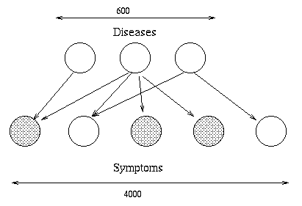

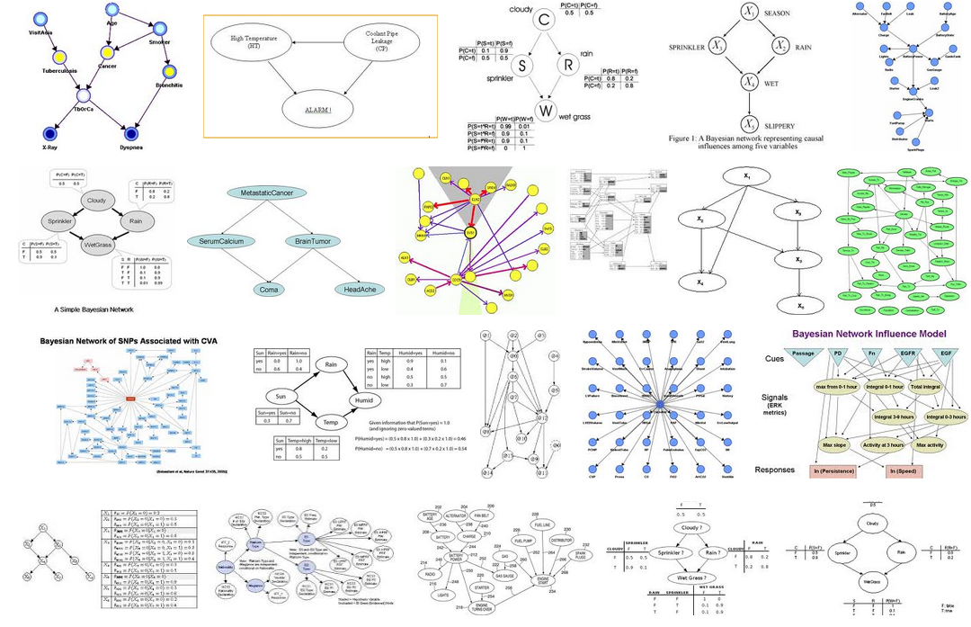
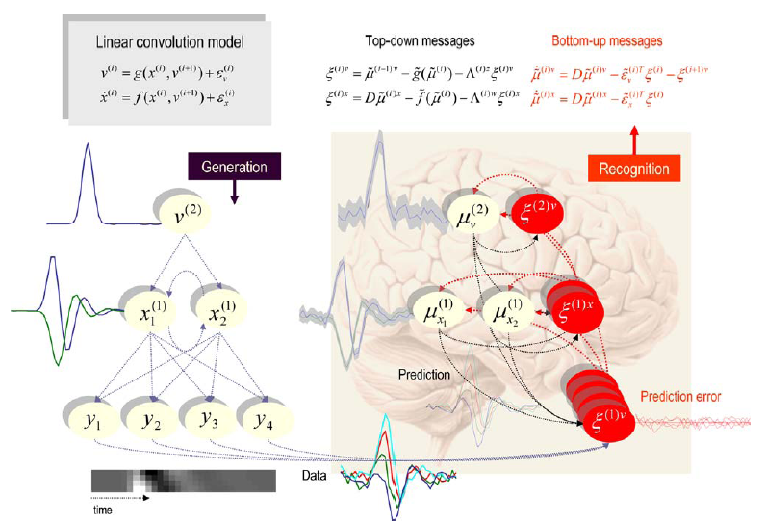
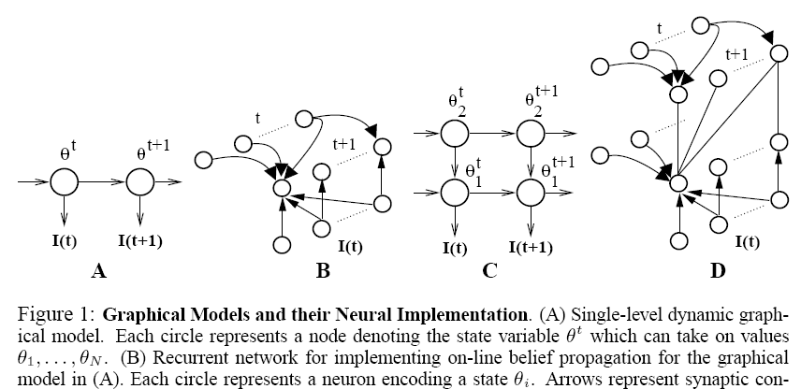
Probabilistic inference engine?
Bayesian networks, graphical models
Notes:
In order to do inference, one approach to design an engine is to use probabilities to model uncertainties and graphical model to represent causal relations. You learned about these a little bit in previous days.

Slide 54
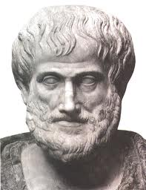
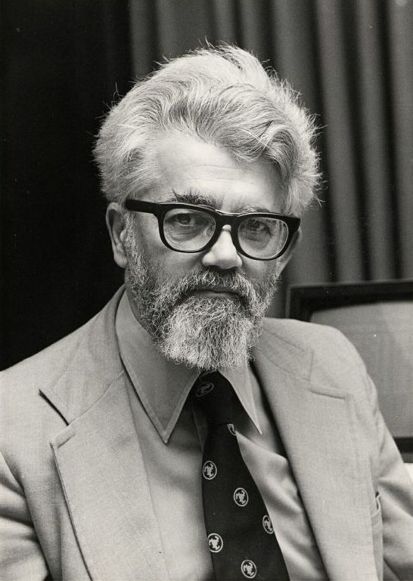
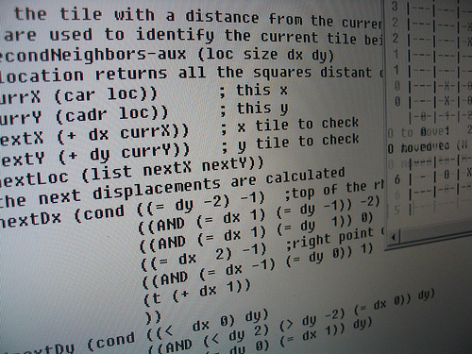
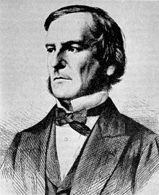
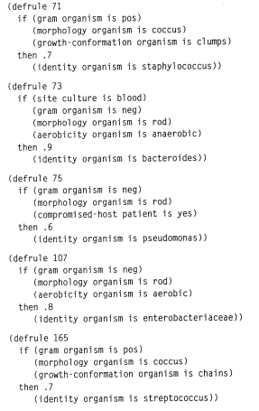






Symbol manipulation engine?
Logic, λ calculus, programming languages
Notes:
In the early days of AI in the 1950s and onwards, symbol manipulation engine was the state-of-the-art. This is similar to C++ programming languages that most of you know. It’s also called expert systems and the idea is to use symbols and syntax to make automation.

Slide 55
Intelligence as symbolic computation
“The infinite use of finite means”
S
I thought that the rug covering the platform was covered in dust, but it was actually covered in the ground-up bodily remains of hundreds of thousands of tiny coral-like organisms who lived millions of years ago at the bottom of an ocean that has long since disappeared, except in the thoughts of certain geologists who remember it all too well.
VP
NP
NP
V
D
N
D
N
The rug covered the platform
I thought that the rug covering the platform was covered with dust, but hundreds of thousands of small coral-like creatures that lived on the bottom of the long sea hundreds of years ago, since then, It disappeared except for the particular geologist's remembrance that I remember.
The rug covering the platform was covered in dust.
I thought that the rug covering the platform was covered in dust, but it was actually covered in silver!
Notes:
We can think of intelligence as symbolic computation. It’s really about flexibility which can be summarized in this phrase ‘Infinite use of finite means’. Linguistic capacity of humans is a perfect example of this flexibility. With very little means of vocabulary and grammar rules, one can compose sentences in infinite ways.

Slide 56

New Integrative Frameworks for Cognitive Science and AI
Probabilistic programs (~2008-present):
Ghahramani (Nature, 2015)
Goodman & Tenenbaum (2014, 2016) https://probmods.org
Integrate our best ideas on intelligence:
Symbolic languages for representation, composition and abstraction.
Probabilistic inference for causal reasoning under uncertainty.
Hierarchical inference for learning to learn.
Neural networks for pattern recognition.
Notes:
Therefore, the new frontier in AI is this integrative approach where we use the best of our knowledge on intelligence. So, in this approach studying how human mind works is interesting because if we can figure out how each one of us managed to learn the game in few minutes, we will have made a big progress in understanding a clever method of learning.
In this session, we will focus on learning and discuss what would be the best way to learn so that it can give rise to flexible behavior and what has been learned is generalizable.

Slide 57







The roots of learning (human and machine)
Notes:
Consider: The math of DL and RL was introduced in these papers published decades ago, 60s-80’s. CLICK they were published mostly in journals of psychology or cognitive science, as models of the most basic animal learning. Think Pavlov’s dogs. Each of these papers was a small step, with a very simple model, but it turned out that these small steps, once we could engineer them at scale, became today’s AI and are now transforming our world. Think what we could do with just a few small steps towards the larger goal of machines that learn like people, like a human child ..

Slide 58





Building an AI like the way children learn
Notes:
Turing, Computing Mathinery and Intelligence

Slide 59

Robots vs. 1 ½ year olds
Notes:
If you haven’t seen these robots, lookup Boston Dynamics on youtube. Some of the robots are very impressive.

Slide 60



Robots vs. 1 ½ year olds
Notes:
These babies don’t look very impressive when we look at their pictures.

Slide 61



Robots vs. 1 ½ year olds
(Warneken & Tomasello)
Notes:
Now let’s look at this video and think about some of the ‘intelligent’ behavior that can be observed here.

